Slide 1



LG TV Sales Talk Guideline
Winning Pack
QNED70 vs. Q7F (vs.UA75!!)
[한국어] Version 1.0_2025 July 25

Slide 2
Confidentiality Request
This material was developed for educational purposes only for LGE employees
and contains confidential information and contents that may cause copyright issues.
Do not share this material externally or show directly to customers.
The images and videos used in this material have no rights to use externally in any case.
For additional questions regarding this document please contact MS Marketing Strategy Team.
Contact : Mina Yun (mina.yun@lge.com),

Slide 3






QNED70 vs. Q7F
1. The Truth About Q7F
제품 Specification
실제 Performance
A
B
Q7F는 프리미엄 브랜드인 QLED 제품으로,
자사 프리미엄 LCD TV 브랜드인 QNED70의 ATA 모델임
한눈에
보기
Vivid Mode에서 동일 컨텐트로 화질 비교 시, Q7F는 QNED70대비 화질 성능이 현저히
떨어질 뿐 아니라, 심지어 UA75에도 뒤쳐지는데, 이는 화질 프로세싱 수준차 때문임
Processing | QNED70A | Q7F | UA75
Upscale / Color / Tone Mapping | 4K Super Upscaling / Dynamic QNED Color / Dynamic Tone Mapping | 4K Upscaling / Color Booster Pro / Supreme UHD Dimming | 4K Super Upscaling / 4K Expression Enhancer / Dynamic Tone Mapping
제품 스펙 적으로는 두 제품 대동소이하고 가격대 또한 동일함
>
<
ATA
Step down price point
Specification |  | QNED70A | Q7F | UA75
Color | Gamut (DCI-P3 Coverage) | 93% 이상 | QNED70 동등 또는 열위 | 90% 이하
Brightness | APL 10% / 100% | - / 300 | - / 300 | - / 300
Price | $ (USD) | $899.00 | $899.99 (999.99) | $628 (Walmart)
*
≥
>
* Picture performance analysis applies to Vivid Mode (@Store Mode) ONLY
Upscale
QNED70
*
α7 AI Processor가 4K Super Upscaling으로 밝은 곳은 더 밝게,
어두운 곳은 더 어둡게 프로세싱 하여 picture detail을 확실하게 표현함
UA75
=
=
4K Upscaling 기능을 소구 중이나, 정교한 프로세싱이 이루어지지
않아, picture detail을 충분히 표현하지 못하여 디테일이 사라짐
Q7F
*75 inch
Color
QNED70
Dynamic QNED Color가 보다 밝고 순도 높고 자연스러운 색을 표현함
=
<
4K Expression Enhancer가 자연스러운 피부표현과 순도 높은 색을 구현함
UA75
* LG internal measuement data by image quality team.
Specific numbers not to be used for anything other than LGE internal training!!
Q7F
정교하지 못한 Color Booster Pro의 컬러 프로세싱 기술로, QNED70 대비 색이 바래 보이는 경우가 많음 (UA75의 색이 더 좋아보이는 경우도 발생)
Tone
Mapping
QNED70
Dynamic Tone Mapping이 화면을 분석하여, 다양한 범위의 밝기와 색상을
세밀하게 표현하여 현실적인 색상 디테일과 선명한 밝기 디테일을 표현함
그렇다면 과연 성능 측면에서도 두 제품이 동일하게 프리미엄
화질을 구현해 내는지, 그리도 Affordable Premium 제품군인
UA75 대비하여 확연한 성능 차이가 있는지 살펴보자
UA75
Q7F
Vivid Mode에서 화면 전체 밝기를 높여 “쨍함＂을 노렸으나, Tone Mapping 기술력 부족으로 색과 디테일이 사라지는 부작용만 남게 됨
* Picture performance analysis applies to Vivid Mode (@Store Mode) ONLY
Notes:
QNED gaming 소구_ 노출되지 않아 이 부분 서치가 이루어지지 않고 있음 → 소구 필요 (사업부장님)

Slide 4

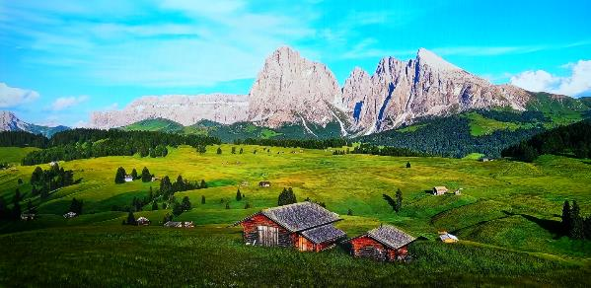
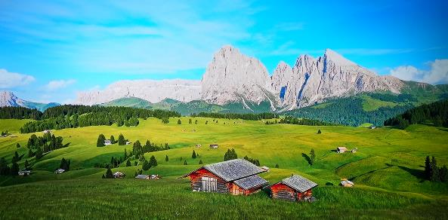
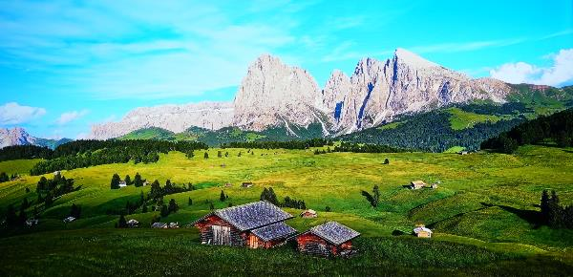



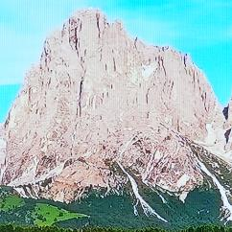
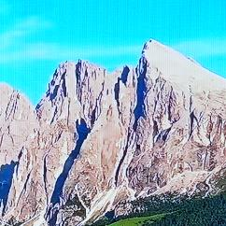
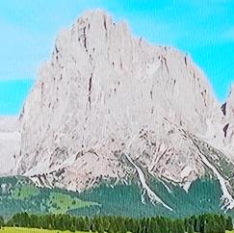
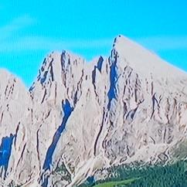
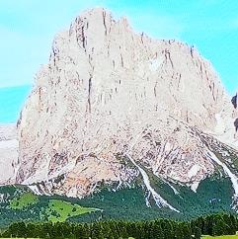
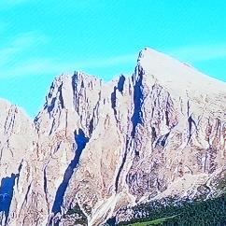
QNED70 vs. Q7F
2.Performance
Upscaling
※ Condition : All TVs set to Vivid Mode(Store Mode), with 4K HDR @60Hz video input from YouTube (Video : at 00:50)
QNED70
Best
Q7F
Bad
UA75
Good
★★
Detailed representation of the mountain folds and
the clouds, along with clear contrast expression
Boosted brightenss erases the details of the mountain folds and the entire cloud. Bad contrast performance.
★
Better details and contrast than Q7F
(even the grass look greener on UA75!!)
* Internal demo. Use the guided TV mode ONLY, with content similar to the samples used. Not to be used for anything other than LGE internal training!!

Slide 5
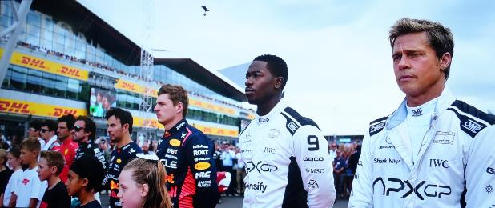
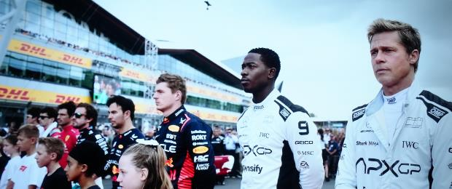
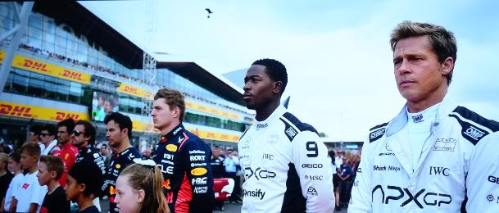
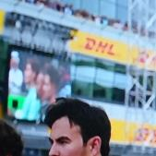

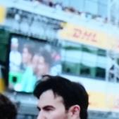

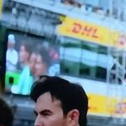

QNED70 vs. Q7F
2.Performance
Color
※ Condition : All TVs set to Vivid Mode(Store Mode), with 4K HDR @60Hz video input from YouTube (Video : at 00:48)
QNED70
Best
Q7F
Bad
UA75
Good
Natural skin tone and detailed expresssion of different range of colors (representing more details)
Also, recognize the DHL logo with the rich yellow?
Due to crude color processing, overall picture looks
washed with lifeless skin tone and lack of color details.
The DHL logo is unrecognizable, if not invisible!!
★
More natural skin tone and color details than Q7F,
with good color intensity.
★★
* Internal demo. Use the guided TV mode ONLY, with content similar to the samples used. Not to be used for anything other than LGE internal training!!

Slide 6
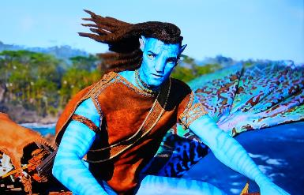
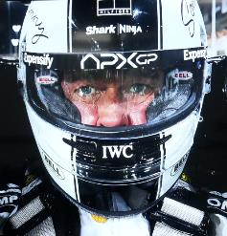
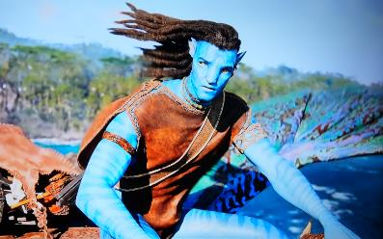
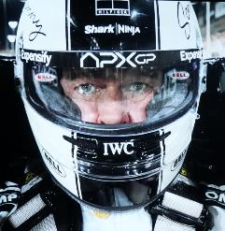
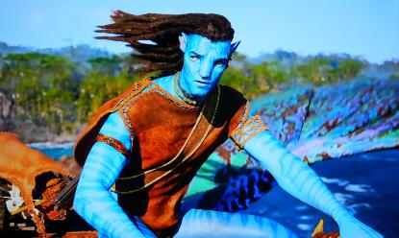
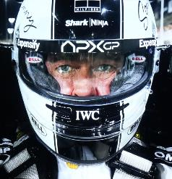

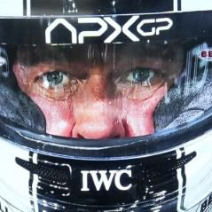
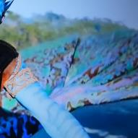
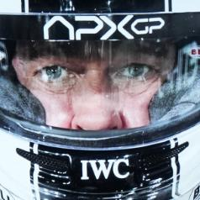
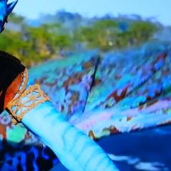
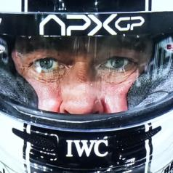
QNED70 vs. Q7F
2.Performance
Tone Mapping
※ Condition : All TVs set to Vivid Mode(Store Mode), with 4K HDR @60Hz video input from YouTube (Video : at 00:25 / at 00:17)
QNED70
Best
Q7F
Bad
UA75
Good
Dynamic Tone Mapping makes sure the fine color
and brightness details are clearly represented.
- The contrast on the wing pattern and the sleeve
as well as the deep forest in the background
- Well preserved deep blacks on the helmet while
the fine facial details are clearly visible
Due to boosted brightness, yet crude tone mapping,
the overall picture brightness is raised without compensation, hampering contrast and color details
- details of the wing and sleeve blurred, colors washed
- raised blacks, pale skin tone and facial details gone.
★★
Compared to Q7F, UA75 has ;
- better contrast and color & brightness range representaiton
(leading to more detailed and vibrant pictures)
- better blacks, natural skin tone and facial details expression.
★
* Internal demo. Use the guided TV mode ONLY, with content similar to the samples used. Not to be used for anything other than LGE internal training!!

Slide 7
Thank You

